Slide 1



CANTEEN
MANAGEMENT SYSTEM
SUBMITTED BY :-
TANMAY AHUJA (210111497)
SURAJ PANDEY(210111499)
B.TECH (C.S.E)
4TH SEMESTER

Slide 2

CONTENT:-
PROJECT OVERVIEW
BACKGROUND
TECHNOLOGY AND SOFTWARE REQUIREMENT USED
METHODOLOGY
FEATURES

Slide 3


PROJECT OVERVIEW:-
It manages all the information about Canteen, Stock ,Item , Category.
This project is used to reduce the manual work for managing the Canteen, Employee, Stock, Customer.
The aim of this project is to manage the details of Canteen, Employee , Customer, Sales, Item category.

Slide 4
BACKGROUND:-
The canteen management system automates canteen operations to improve efficiency and accuracy.
It replaces manual processes such as paper-based order forms and inventory records.
The system offers a more convenient and streamlined ordering experience, helping organizations save time, reduce costs, and improve customer satisfaction.

Slide 5
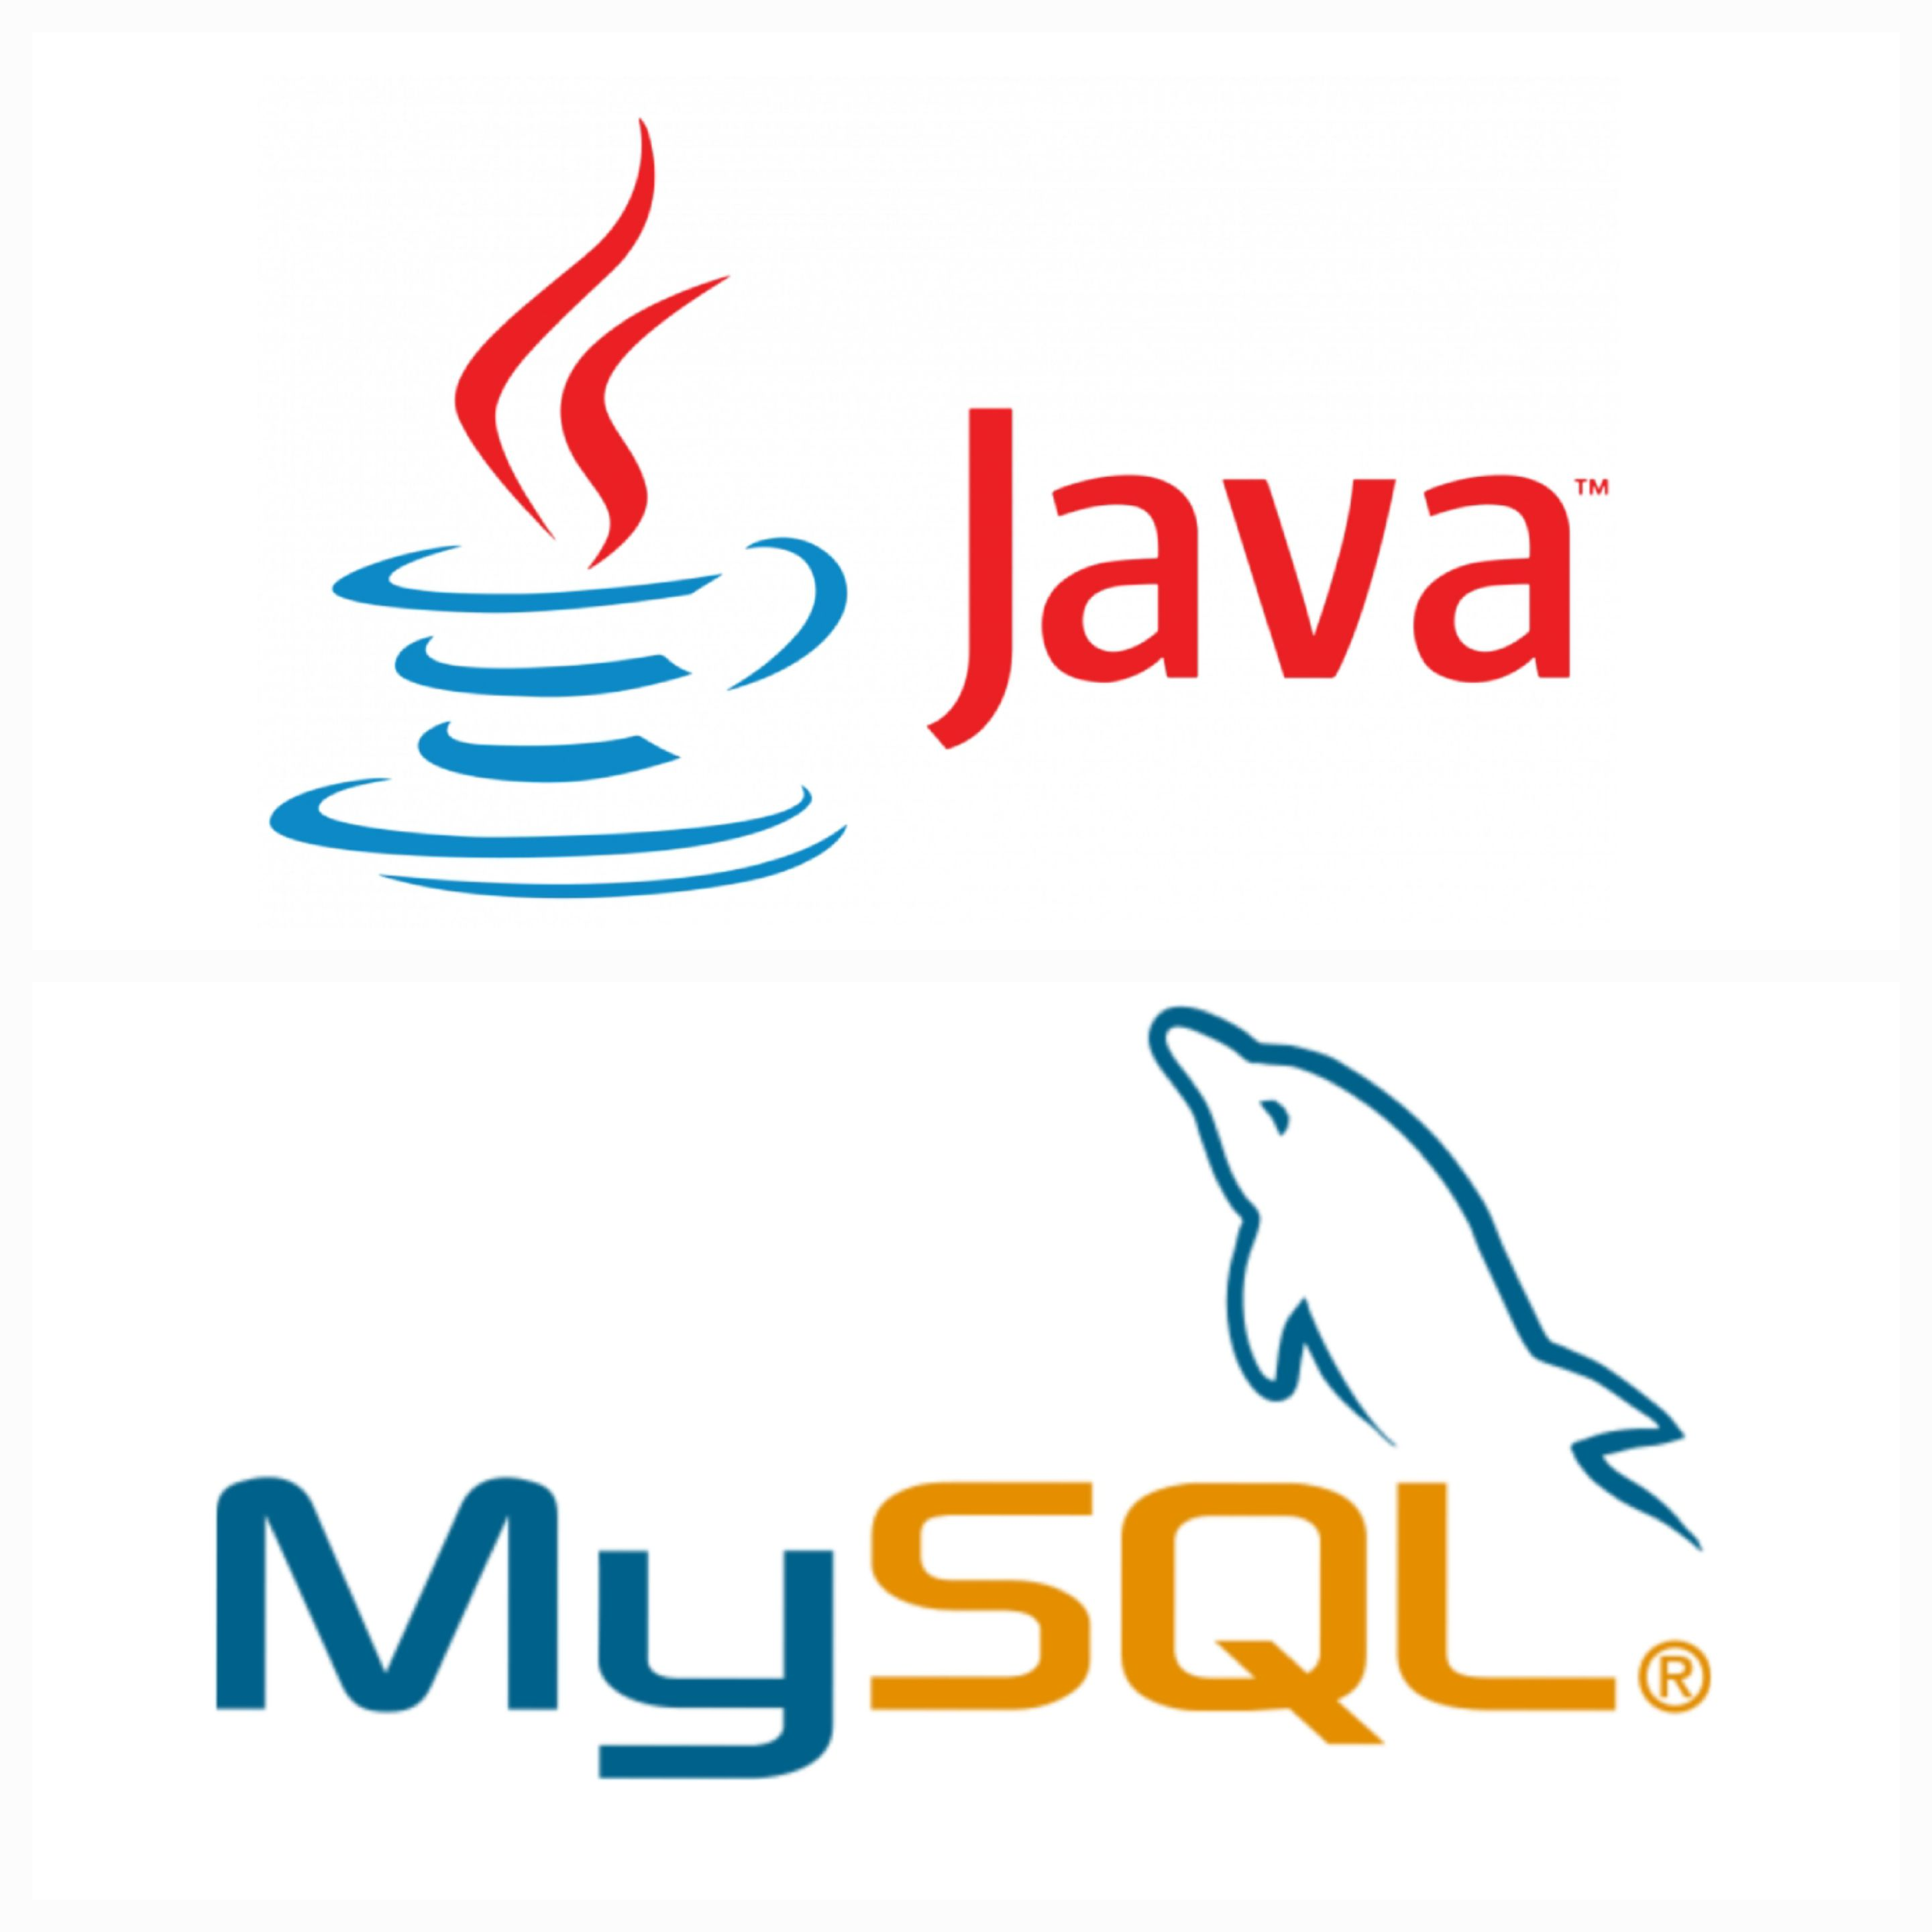

TECHNOLOGY AND SOFTWARE REQUIREMENT USED:-
JAVA
MySQL
IntelliJ Idea

Slide 6




METHODOLOGY:-
Showing list of Items
Taking Customer Order
Checking if item is available in stock
Generating Bill
Asking Payment Options
Taking feedback

Slide 7
FEATURES:-
01
Canteen management system is a software application designed to automate the process of managing canteen operations.
02
The system is built using Java programming language and MySQL database.
The system uses MySQL database to store all the data related to canteen operations such as menu items, orders, inventory and user information.
The system also provides various reports such as sales report, inventory report, and order report.
03
04

Slide 8



Contact Us
TANMAYAHUJA.210111497@GEHU.AC.IN
SURAJPANDEY.210111499@GEHU.AC.IN

Slide 9

Thank You

